Slide 1
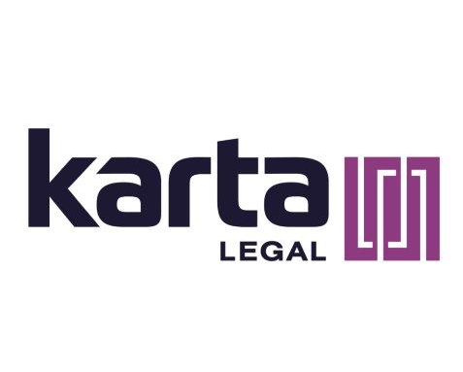
The future is Now: AI Driven Innovation for the forward-thinking Law Firm
Sonjui Kumar – Partner, KPPB Law
Lourdes Fuentes – CEO & Founder, Karta Legal LLC
Nicole Tineo – COO, Karta Legal LLC

Slide 2
Understanding generative ai in the legal field
Generative AI Defined
Current Applications in Law
Benefits for Legal Practices
Real-World Examples & Case Studies

Slide 3
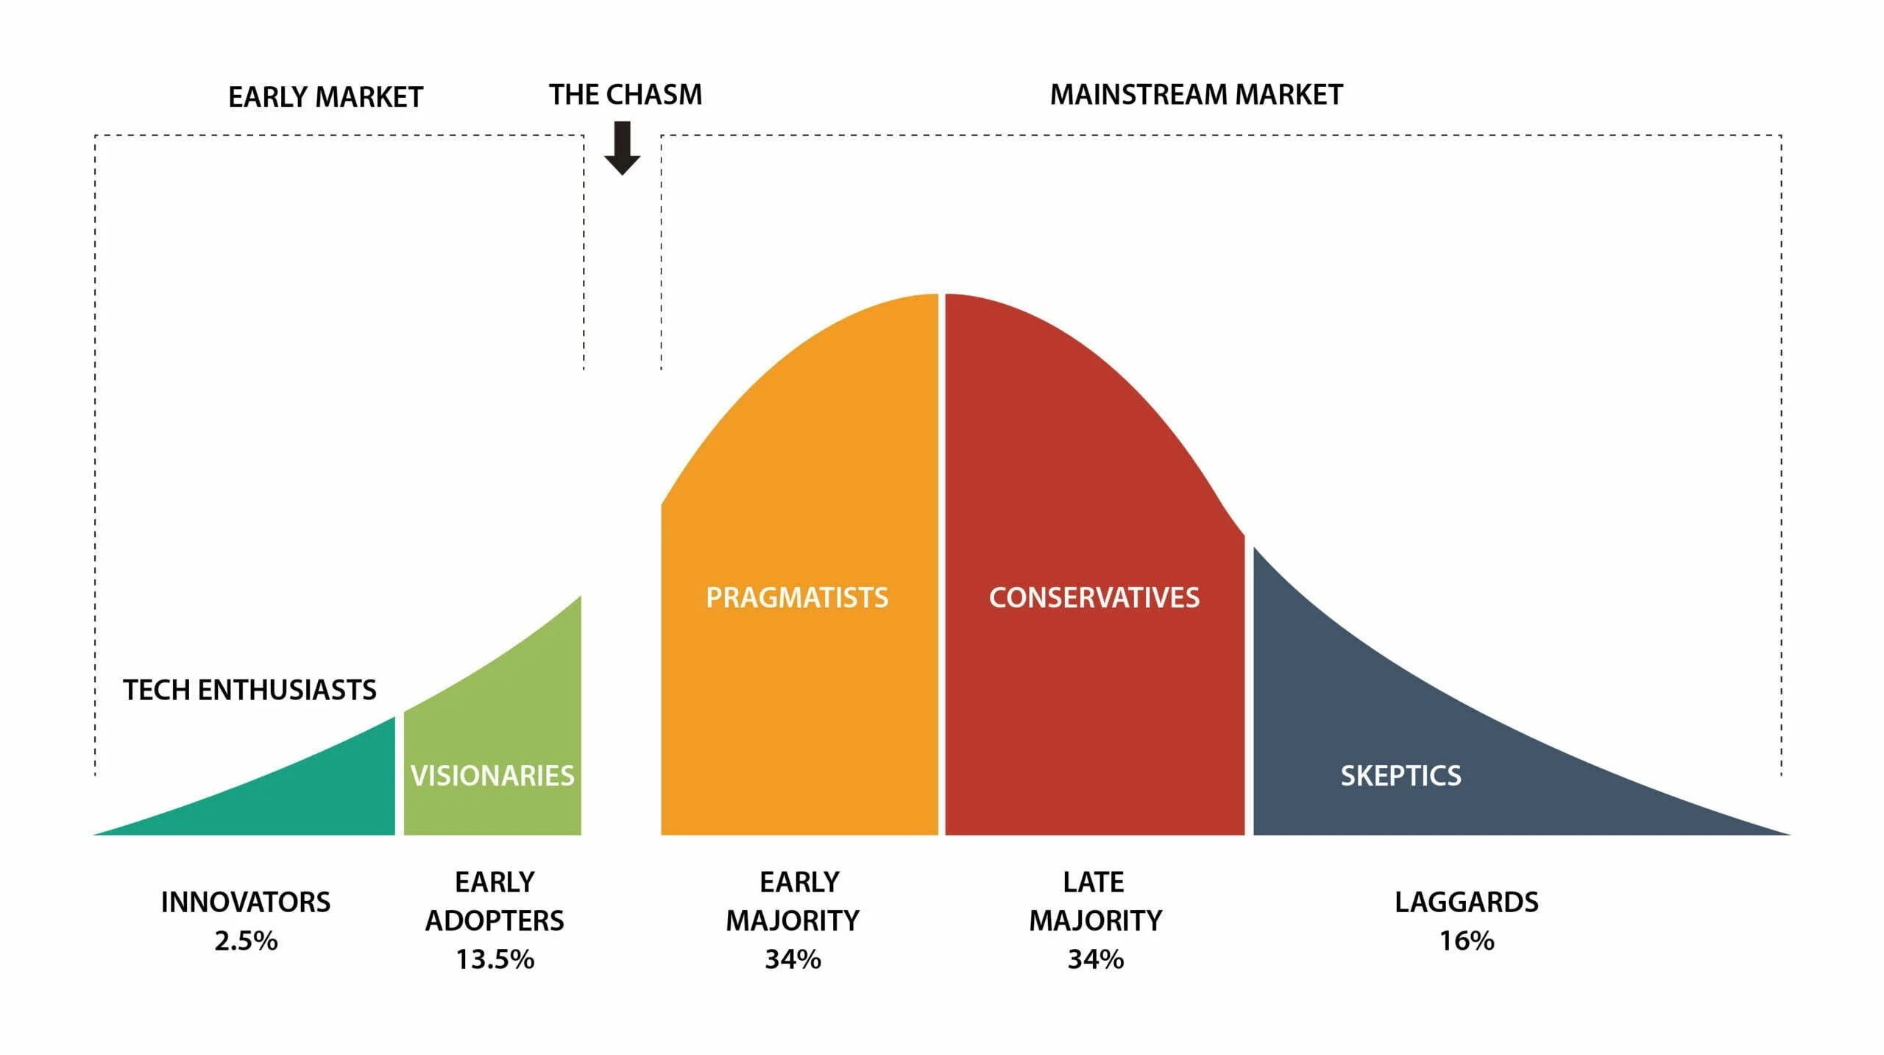
Roger’s diffusion of innovation model

Slide 4
Generative AI Tools and Their Applications
Document Automation & Drafting (e.g., contracts, pleadings)
Legal Research Enhanced by AI
Predictive Analytics in Litigation & Client Counseling
AI in Compliance & Due Diligence
Questions

Slide 5
Building Your Legal Tech Stack: Essentials for Today’s Practice
Case Management Systems
Document Management Systems
Secure Communication & Collaboration Platforms
E-Discovery & Litigation Support Tools
Timekeeping & Billing Software
Client Relationship Management (CRM) Systems

Slide 6
Integrating Generative AI into Your Legal Tech Stack
Strategies for Seamless Integration
Training & Adaptation for Legal Teams
Ethical Considerations & Best Practices
Managing Client Expectations & Data Security

Slide 7
Roadmap for Implementation
Step-by-Step Guide to Adopting AI and Updating Tech Stack
Resources for Further Learning and Support

Slide 8
Interactive Workshop
Group Discussion & Idea Sharing

Slide 9
Conclusion
Summary of Key Takeaways
Call to Action: Embracing Innovation for Growth and Efficiency
Question

